Slide 1
RAJALAKSHMI ENGINEERING COLLEGE
Design Thinking and Innovation
Project Title
FINAL PROJECT REVIEW
Empathize
Ideate
Prototype
Test

Slide 2
Team Introduction & Agenda
Our Team
Presentation Agenda
1
EMPOWER
01
Problem Statement
2
BHARKAVI N(231801023) — MOBILE APP DEVELOPMENT & TESTING
02
Design Process (Empathize → Test)
3
HEMALATHA L*(231801055) — DATABASE INTEGERATION & RESEARCH
03
Final Solution & Prototype Demo
4
MOGHANAPRIYA R(231801102) — BACKEND & DOCUMENTATION
04
Testing & Validation Results
05
Reflections & Key Learnings
2

Slide 3
Problem Statement
Point of View (POV) Statement
[User] needs [need] because [insight]
→ Write your team's POV statement here clearly and concisely.
🎯 The Challenge
👤 Who is Affected?
💡 Why It Matters
Women traveling alone
Students returning late at night
Elderly people living independently
Individuals in isolated or unsafe locations
Many individuals, especially women, students, and people traveling alone at night, face unsafe situations where immediate help is difficult to access. Existing emergency systems depend heavily on internet connectivity and manual communication, which may fail during critical situations.
Delays in emergency response can lead to severe consequences. A smart safety solution capable of providing rapid alerts, location tracking, and offline emergency communication can significantly improve personal safety and emergency response efficiency.
3

Slide 4
🫂
Stage 1
Empathize
Empathize
Define
Ideate
Prototype
Test
📌 What We Did
🛠 Methods & Tools
✅ Key Takeaway
We interacted with students, working professionals, and frequent night travelers to understand their safety concerns and emergency communication challenges.
✔ User Interviews ✔ Online Surveys ✔ Empathy Mapping ✔ Observation-Based Research
Users wanted:
Faster emergency communication
Offline alert capability
Easy-to-use SOS system
Reliable location sharing during emergencies
‘’In dangerous situations, people need im.”mediate help without wasting time unlocking apps or searching for contacts’’
5

Slide 5
🎯
Stage 2
Define
Empathize
Define
Ideate
Prototype
Test
📌 What We Did
🛠 Methods & Tools
✅ Key Takeaway
After the empathy stage, our team analyzed user feedback and identified key safety challenges during emergencies. We found that users faced difficulties in quickly contacting others, sharing live location, and getting help in low-network situations.
Based on these insights, we defined the need for a smart, reliable, and easy-to-use emergency safety solution.
POV (Point of View) Statement
How Might We (HMW) Questions
Problem Framing
User Pain Point Analysis
Emergency Scenario Mapping
Refined Problem Statement
Solo travelers, women, students, and elderly individuals need a fast and reliable emergency safety system because existing solutions often fail during critical situations due to internet dependency and delayed communication.
6

Slide 6
💡
Stage 3
Ideate
Empathize
Define
Ideate
Prototype
Test
📌 What We Did
🛠 Methods & Tools
✅ Key Takeaway
During the ideation stage, our team conducted brainstorming sessions to generate multiple ideas related to personal safety and emergency response systems. We explored different approaches such as smart SOS alerts, AI-based fall detection, offline emergency communication, and risk zone monitoring.
After evaluating feasibility, user needs, and real-world impact, we finalized an intelligent mobile safety application that provides fast emergency support and reliable alert mechanisms.
💡 Brainstorming
Smart emergency communication
AI-based safety monitoring
Offline emergency alerts
Location-based emergency response
🛠 Methods & Tools
POV (Point of View) Statement
How Might We Questions
Problem Framing
User Pain Point Analysis
Emergency Scenario Mapping
Total ideas generated: 8
Top 3 concepts shortlisted:
1. Smart SOS Emergency System
2. AI-Based Fall Detection
3. Geo-Based Risk Zone Alert System
Concept selected for prototyping:
→ GEOSHIELD – AI-Powered Personal Safety System
7

Slide 7
Our Final Solution
Solution Name:
✅ Selected
GEOSHIELD
🔑
⚡
🌟
Core Feature 1
Core Feature 2
Core Feature 3
Smart SOS System
Users can instantly trigger emergency alerts with a single tap, automatically sending location details to emergency contacts.
Offline SMS Emergency Support
When internet connectivity is unavailable, the system automatically switches to SMS-based emergency communication.
AI-Based Safety Monitoring
Rule-based intelligent monitoring detects suspicious situations such as falls, inactivity, and unsafe zone entry.
10

Slide 8
🔨
Stage 4
Prototype-System Architecture
Prototype
8

Slide 9
🔨
Stage 4
Prototype-Modules Description
Prototype
8

Slide 10
🔨
Stage 4
Prototype-Modules Description
Prototype
8

Slide 11
Prototype Demo & Impact
🔨 Prototype Walkthrough
🌍 Expected Impact
[ Insert Prototype Screenshot / Photo / QR Code Here ]
👥
Users Benefited
Women, students, elderly people, and solo travelers
🎯
Problem Addressed
Emergency communication delay during unsafe situations
📈
Measurable Outcome
Faster emergency response and improved personal safety
Demo Link / QR Code: ___________________________
🔁
Next Iteration
Prototype Type: Digital
AI prediction models, wearable integration, and cloud analytics
11

Slide 12
🧪
Stage 5
Test
Empathize
Define
Ideate
Prototype
Test
📌 What We Did
🛠 Methods & Tools
✅ Key Takeaway
We tested the GEOSHIELD prototype with students and mobile users to evaluate usability, emergency response flow, and alert functionality. Users were asked to perform tasks such as triggering the SOS button, adding emergency contacts, and navigating through the auto-detection features.
Feedback was collected through direct observation, user interaction analysis, and verbal suggestions to identify usability improvements and feature effectiveness.
Usability Testing Sessions
Feedback Capture Grid
Expert Review / Heuristic Evaluation
Users tested: 12 Users
What worked well:
→ Fast SOS emergency triggering → Easy-to-use and attractive interface
What needed improvement:
→ Background battery optimization and alert response timing
Changes made after testing:
→ Improved UI navigation, optimized emergency workflow, and refined alert handling system
9

Slide 13
Testing & Validation · Reflections & Learnings
12
3
92%
Users Tested
Feedback Rounds
Task Success Rate
📊 Validation Results
💬 Team Reflections & Learnings
✅
What Worked Well:
🧠
Biggest Learning:
Fast SOS response, easy navigation, and reliable emergency alert functionality.
Design Thinking helped us convert real user safety problems into a practical and user-friendly mobile solution through continuous feedback and improvement.
⚠️
What Needed Improvement:
🤝
Teamwork Insight:
Battery optimization and background detection performance required improvement.
Team collaboration and diverse ideas improved the app’s usability, emergency workflow, and overall feature design.
🔁
Changes Made:
🚀
If We Had More Time:
Enhanced UI flow, alert handling, and auto-detection accuracy.
We would improve background monitoring, enhance AI detection accuracy, and integrate wearable device support.
📌
Final Validation:
🎓
Course Takeaway:
GEOSHIELD successfully provided a smart, reliable, and user-friendly emergency safety solution.
This project strengthened our skills in user-centered design, rapid prototyping, testing, and iterative development for real-world problem solving.
12

Slide 14
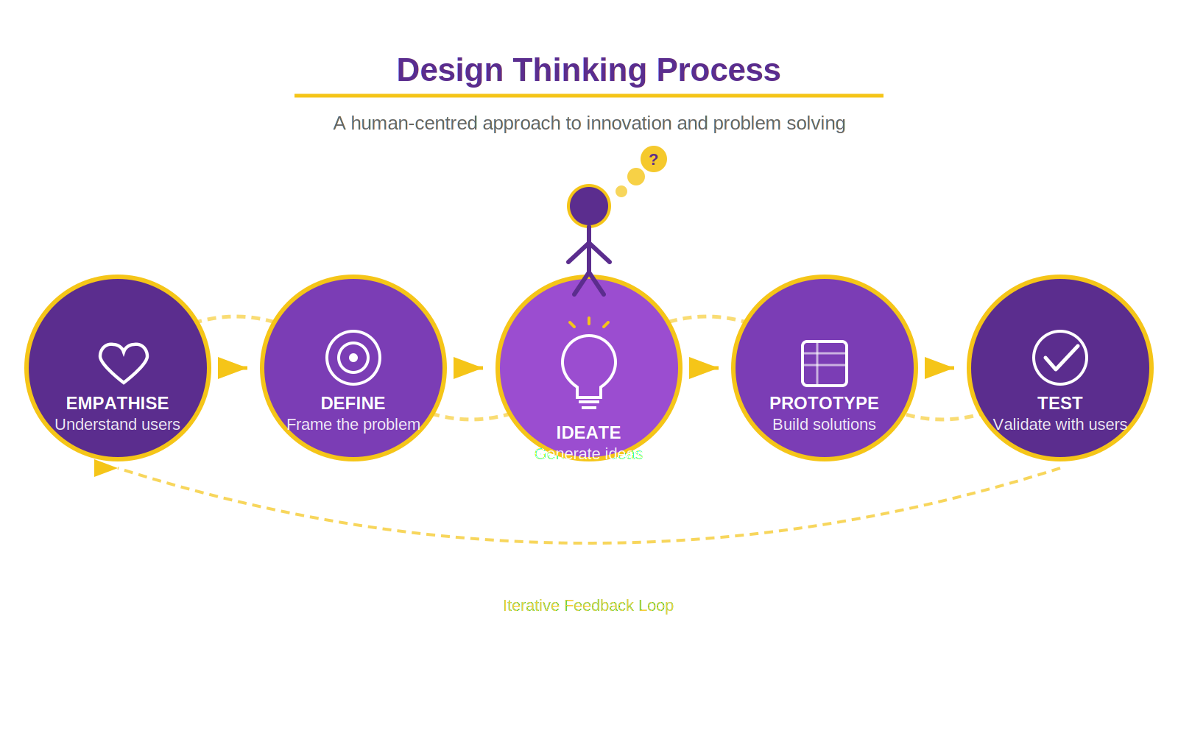
Thank You!
We welcome your questions and feedback.
RAJALAKSHMI ENGINEERING COLLEGE
"Engineer Your Future"

